Slide 1
Internet coaches for problem-solving in introductory physics: Data Analysis
Qing Xu¹, Leon Hsu¹ , Ken Heller¹, Bijaya Aryal²
1. University of Minnesota– Twin Cities
2. University of Minnesota– Rochester
AAPT Summer 2012 Meeting
Philadelphia, PA
Supported by NSF DUE #0715615 and by the University of Minnesota—Twin Cities
Notes:
DH04 Tue 07/31, 9:00AM - 9:10AM by Qing Xu Type: Contributed

Slide 2
Comparisons
Comparison #1: Two groups of students within the coach class.
Controls for class environment but sensitive to contamination.
Comparison #2: Coach class and the comparison class.
The contamination problem is much smaller, but it introduces more variables.

Slide 3
Problem Solving Rubric ¹
Useful Description (UD)
Physics Approach (PA)
Specific Application of Physics (SAP)
Logical Progression (LP)
Mathematical Procedure (MP)
J. Docktor, Ph.D. Thesis, University of Minnesota, Twin Cities, 2009;
Docktor & Heller, AIP Conference Proceedings 1179, 2009, pp. 133-136.
Notes:
MP: Sanity check which is not addressed in the coaches

Slide 4
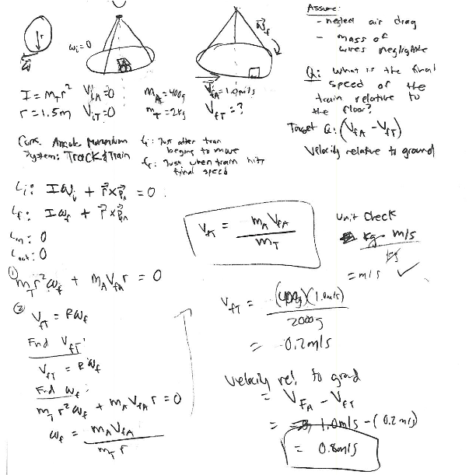
UD: 5
PA: 5
SAP: 4 relative velocity;
LP: 5
MP: 5

Slide 5
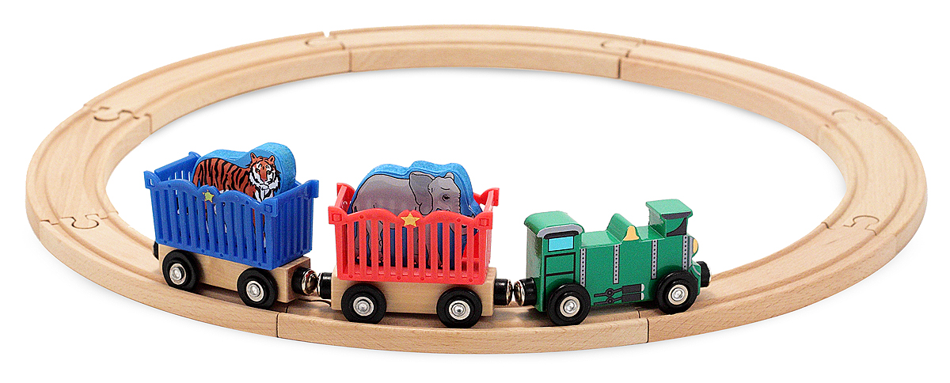
You are helping to design a display at a toy store and decide to build a suspended track on which a toy train will run. The track will be a horizontal circle hung from three thin wires attached to a pivot on the ceiling so that it can rotate freely. The train is started from rest and accelerates without slipping to a final speed of 1.0 m/s relative to the track. Because the store owner is worried about the possibility of an accident where the train jumps off the track and falls on a customer, you are asked to find its final speed relative to the floor. The mass of the train is 400 g and the mass of the track is 2 kg. The radius of the circular track is 1.5 m.

Slide 6
Data analysis
Inter rater reliability: Raters trained by first scoring a common set of 10 student solutions, comparing and discussing their ratings, then repeating the process until their agreement was at least 90% before discussion.
159 students with a complete set of data were used in the analysis.
4 quiz problems and 2 final exam problems (kinematics, COE/COM)
A matched set of 24 students from the Frequent Completer (FC)and Less frequent Completer (LC) group.
Notes:
FC 34
LC 21

Slide 7
Within Class Comparisons
Notes:
Final problem: Kinematics , COM COE

Slide 8
Within Class Comparisons

Slide 9
Within Class Comparisons

Slide 10
Within Class Comparisons

Slide 11
Within Class Comparisons

Slide 12
Between Class Comparison
99 students – matched on FCI pre, Math pre, and CLASS pre scores.
 |  | FCI pre | FCI post | Math pre | Math post | CLASS pre | CLASS post
99 matched students | Coach class | 57.9% | 81.2% | 62.9% | 73.5% | 65.4% | 61.2%
 | Comparison class | 57.9% | 75.2% | 62.7% | 69.6% | 65.4% | 56.2%
 | P-value of T-Test |  | <0.01 |  | 0.06 |  | 0.06
The entire class | Coach class | 57.9% | 78.4% | 64.3% | 73.0% | 63.4% | 60.0%
 | Comparison class | 59.6% | 75.7% | 62.6% | 69.5% | 62.9% | 54.2%
 | P-value of T-Test | 0.61 | 0.11 | 0.40 | 0.75 | 0.33 | 0.11

Slide 13
Between Class Comparisons
Notes:
NA replaced with 5, 3.7 +/- 0.19
4.4 +/- 0.10

Slide 14
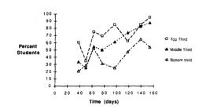
Summary
The computer coaches were used on top of the cooperative group problem solving pedagogy, and combined use of individually effective pedagogies may not show a cumulative gain.²
A long enough timescale may be needed for any effects of the devolvement of problem solving.³
2. K. Cummings, J. Marx, R. Thornton and D. Kuhl, Am. J. Phys. 67, S38-S44 (1999).
3. P. Heller, R. Keith, and S. Anderson, Am. J. Phys 60, 627-636 (1992).

Slide 15
Poster Session
PST2A39 & PST2A40 Houston Hall, 6 – 7:30 p.m. tonight
http://groups.physics.umn.edu/physed
Thanks!

Slide 16
Final exam scores (25 points/problem)
 |  | Final P1 | Final P2 | Final P3 | Final P4 | Final P5
Points | Treatment_Prof.A | 18.6 | 17.6 | 11.8 | 14.3 | 15.8
 | Control_ Prof.B | 19.9 | 12.7 | 14.1 | 9.8 | 16.2
 | P-value of T-Test | 0.15 | <0.01 | <0.01 | <0.01 | 0.72
Percentile | Treatment_Prof.A | 0.50 | 0.51 | 0.53 | 0.53 | 0.50
 | Control_ Prof.B | 0.51 | 0.50 | 0.51 | 0.50 | 0.51
Notes:
Percentile doesn’t make sense ? Look at the distribution.

Slide 17
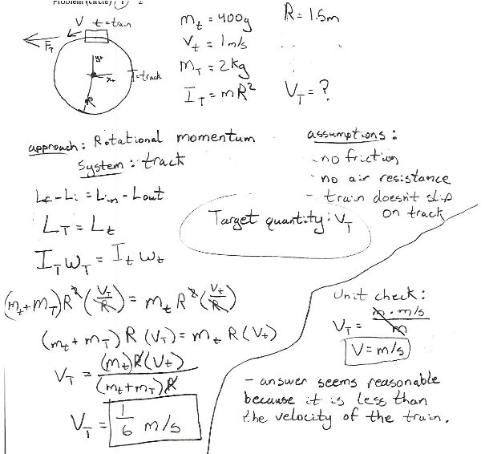
UD: 3 Missing Vtrack; Vtrain relative velocity;
PA: 5
SAP:3 application of I(train); relative velocity;
LP: 5
MP: 4 wrong numerical calculation;

